Slide 1

Toronto City Pulse: Analyzing Delivery Delays using Weather and Traffic
A Data Analytics Project Using Python
By Naufiya Rasheed

Slide 2
Why This Matters
In a busy city like Toronto, delivery delays are common.
Are weather or traffic conditions causing these delays?
How can data help us understand and potentially solve this problem?

Slide 3
What We Set Out To Do
Simulate real-world delivery data in Toronto
Enrich it with weather and traffic conditions
Analyze how these factors impact delivery duration
Provide actionable insights

Slide 4
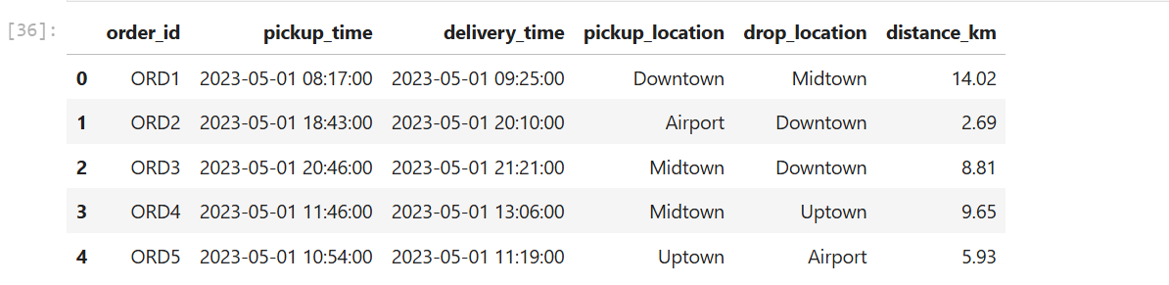
Data Simulation Step 1 – Generating Delivery Data
Created 100 mock delivery records with:
Pickup & drop times
Locations (Downtown, Uptown, etc.)
Randomized distances
Calculated total delivery duration in minutes
Used Python libraries: pandas, datetime, random

Slide 5

Weather Data Integration Step 2 – Adding Real-World Weather
Used OpenWeatherMap API to fetch weather info for Toronto
Extracted temperature, conditions (e.g., Clear, Rain, Cloudy)
Tagged each delivery with simulated weather based on date
Used: requests, API integration

Slide 6
Traffic Simulation Step 3 – Simulating Traffic Conditions
Tagged each delivery with traffic levels: Low, Medium, High
Randomized for simplicity (can be enhanced with live APIs later)
Used Python random.choice()

Slide 7
Data Preparation Cleaning & Structuring the Data
Converted time columns to datetime
Calculated delivery duration in minutes
Combined weather and traffic into the dataset
Used pandas for transformation

Slide 8
Exploratory Analysis How Long Do Deliveries Take?
Created histogram of delivery durations
Most deliveries took between 30–60 minutes
Visualized using: matplotlib, seaborn

Slide 9
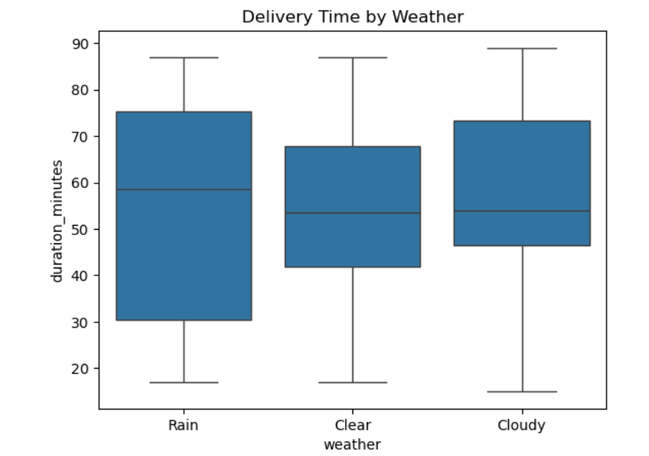
Weather Impact on Deliveries Does Weather Matter?
Used a boxplot to show delivery time across weather types
Key Insight: Rainy days had longer delivery durations
Conclusion: Poor weather leads to slower deliveries

Slide 10
Traffic Impact on Deliveries What About Traffic?
Boxplot comparison of delivery time by traffic level
Key Insight: High traffic clearly increases delivery time
Conclusion: Traffic congestion significantly affects efficiency

Slide 11
Summary of Findings What Did We Learn?
Rainy or cloudy conditions increase delivery delays
High traffic levels are the biggest contributor to longer deliveries
Data-driven approaches can help logistics companies optimize routes and timings

Slide 12
Next Steps
Add real-time traffic API data (e.g., Google Maps)
Predict delivery times using machine learning
Build a live dashboard for logistics monitoring

Slide 13

Thank you

